Slide 1
The Seven Seals
Revelation 6:1 – 8:5

Slide 2
The Four Horses & Riders
(6:1-8; cf. Zech. 1:7-11; 6:1-8)
  “four” the world in full and in view of where men live (Rev. 7:1)
  each of the first four seals has a horse which is often associated with war (Job 39:19-25)
  each is introduced by a living creature
  each is something to be seen, not read
    “come and see” (6:1, 3, 5, 7)

Slide 3
WHITE HORSE (6:1, 2)
  signifies victory
  bow (warrior)
  wears crown that was given to him
  goes forth to conquer (war)

Slide 4
WHITE HORSE (6:1, 2)
  Identity?
    Possibly symbolizes the Christ going forward with the gospel
    Possibly just an equal to one of the other three forces of war that would ravage the earth as God would permit

Slide 5
RED FIERY HORSE (6:3, 4)
  carnage, had a great sword
  would kill one another
    possible civil war
    “kill” translated “murder” (1 Jn. 3:12); “slain” (Rev. 5:6, 9, 12; 6:9; etc.)
  purpose to take peace away from the earth

Slide 6
BLACK HORSE (6:5, 6)
  what might this color represent?
    mourning/grief
    “The word of Jehovah that came to Jeremiah concerning the drought. Judah mourneth, and the gates thereof languish, they sit in black upon the ground; and the cry of Jerusalem is gone up” (Jer. 14:1, 2, ASV)

Slide 7
BLACK HORSE (6:5, 6)
  what did this rider carry?
    scales/balance
  scarcity of food and rampant inflation
    quart of wheat for a denarius/day’s wage (Matt. 20:2)
    oil and wine not hurt

Slide 8
PALE HORSE (6:7-8)
  translated green (Mk. 6:39; Rev. 8:7; 9:4)
  rider is death personified
    the natural effect from the other three horses
    death shown to be a lethal tyrant (Rom. 5:14; 6:9)
  hades as a companion follows with him
    death to the body; hades to the soul
    1/4th of earth fell (sword—hunger—death—beasts)

Slide 9
“Many are the modern references to ‘the four horsemen’ of this passage, but few understand that they rightfully declare the sovereignty of God. He permits the horsemen to ride. He controls them. He limits them. And he stops them when they have served their purpose.”
Robert Harkrider, “Revelation,” Truth Commentaries p. 87

Slide 10
The Four Horsemen
were limited in their scope of devastation
should teach us not to be naïve about the cost of living godly in this world
  Matthew 5:10-12, 44; 10:21, 22, 34

Slide 11
The Four Horsemen
should teach us of the effects of living in a sin-cursed world
  war and social disruption against the community of peace (Gen. 4:8; 6:11, 12)
  famine against the bounty of the earth (Gen. 3:17, 18; 5:29; 12:10; Ruth 1:1; 2 Sam. 21:1; 2 Kin. 6:25; Amos 4:6; etc.)
  sickness and death against the body (Gen. 3:19, 24; 5:5ff; Deut. 28:59; Heb. 9:27; etc.)

Slide 12
The Four Horsemen
should make us yearn all the more to reach the heavenly refuge
  “And God will wipe away every tear from their eyes; there shall be no more death, nor sorrow, nor crying. There shall be no more pain, for the former things have passed away” (Rev. 21:4)

Slide 13
FIFTH SEAL (6:9-11)
Martyred Saints
  why were they “under the altar?”
    Slain
  why were they slain?
    word of God and testimony
  suggests an apparent defeat of the righteous—murdered for the word of God
  dead but still conscious

Slide 14
FIFTH SEAL (6:9-11)
Martyred Saints
  want avengement
    not personally meeting out revenge as was warned against (Rom. 12:17; 1 Thess. 5:15)
    giving place to wrath is to turn it over to God (Rom. 12:19)
    it is just for evil to be punished one day
    (Deut. 32:43; 2 Thess. 1:6, 7)
    exoneration (Rev. 20:4-6)

Slide 15
Triumph & Tragedy
(v. 11)
saints were given a robe of white
  they had fought the good fight and remained faithful
  had finished their course
  will rest
many more saints will be allowed to die

Slide 16
SIXTH SEAL (6:12-17)
end of world or end of empire?
  most likely the end of Roman rule with this seal being the answer to 6:10 (cf. 19:1, 2)
  some argue the possibility of the final day of wrath where Revelation is divided into seven sections—every section spans the entire Christian dispensation to the second coming
POINT: A great day of wrath is coming and “Who Is Able To Stand?” (6:17)

Slide 17
SIXTH SEAL (6:12-17)
sun became black; moon to blood; stars of heaven fell
  typical language of judgment cf. Is. 13:9-13
sky receded as a scroll (cf. Is. 34:4)
people of all stations wanting cover from God (cf. Is. 2:10-21, against pride/idols)
  a prefigure of final judgment 20:12
NO ONE CAN STAND BEFORE THE WRATH OF THE LAMB!

Slide 18
Some Lessons:
Wherever the gospel travels is where persecution will arise (Matt. 10:34; Jn. 15:18, 19; 1 Jn. 3:13)
The Lord answers the prayers of the righteous (Prov. 15:29; Jas. 5:16; 1 Pet. 3:12)
FEAR GOD, not the world; HOPE IN GOD, not the world (Rev. 14:7)

Slide 19
The Redeemed
Those Who Can Stand Before The Lamb Are Standing With the Lamb
Revelation 7:1-17
(an interlude between the 6th & 7th seal)

Slide 20
Review
Christ and the Seven Churches (1-3)
The condition of John and the image of Christ (1)
  what is the nature of the book?
  what is the condition of John?
  what does the description of Jesus convey?

Slide 21
Review
Christ and the Seven Churches (1-3)
The seven churches (2, 3)
  What churches have nothing negative spoken against them?
  What church has nothing good spoken for it?
Throne Scene (4, 5)
  On and around the throne (4)
  The dilemma (5)

Slide 22
Review
Christ opening the first six seals (6)
What did the first four seals reveal?
  First seal? conquering
  Second seal? no peace, carnage
  Third seal? scarcity of food, mourning
  Fourth seal? death in various ways

Slide 23
Review
Christ opening the first six seals (6)
What did the fifth seal reveal?
  murdered saints
  below the altar—an apparent victory over good
What did the sixth seal reveal?
  avenging of the saints by the Lamb

Slide 24
Preparation for Retribution & Protection (7:1-3)
Verse 1 –4 angels at 4 corners
  restraining wind (destruction) of the earth and the sea
  more internal evidence against the “destruction of Jerusalem” view

Slide 25
Revelation 7:1-3
another angel from east (v. 2)
reveals angelic purpose for harm
  not to harm earth until saints are sealed
sealing is certifying (cf. Esther 3:12)
on forehead
  received the word through minds
  being a Christian is to be evident

Slide 26
GOD KNOWS HIS EVERY SAINT!
(2 Timothy 2:19)
Compare similar passage: Ezekiel 9:1-11

Slide 27
Identifying the 144,000
NT Christians
(Jew & Gentile)?
OT Saints?
Both?
144,000 = 12 X 12 X 10 X 10 X 10
“12” religion, covenant
“10” full
“3” complete

Slide 28
The Text Does Not Teach
What Jehovah Witnesses Say
  literal 144,000 to enter heaven
  great multitude (v. 9) to enter rejuvenated earth
If so. . .
  then “tribes” must be literal and therefore no Christians will enter heaven
  then apostle John wrote it down backwards: 144,000 (earth); great multitude (heaven)

Slide 29
Theory 1
“144,000” (7:4) are the same as the “great multitude” (7:9) –Harkrider
  144,000 view is on earth/great multitude is redeemed of all ages as more than conquerors viewed in heaven
  12 tribes refer to the church (Lk. 22:29, 30)
  144,000 are standing with Lamb (14:1); therefore Christians

Slide 30
Question about Theory 1
If in heaven, why did John hear they “were sealed” (past tense)?
144,000 seems to imply a fixed number of some sort as opposed to the unfixed multitude in verse 9

Slide 31
Theory 2
“144,000” are OT Saints; “great multitude” are Christians (Ogden)
  seems to give satisfactory explanation of why the group in (7:9) are innumerable: Christians are continuously added to the church
  those under O.T. are forever sealed and set (no more can be added to that system)
  asserts that reference in 14:1 are standing on Zion and therefore are O.T. saints

Slide 32
Questions for Theory 2
why are 144,000 alone singing a new song if not Christians (14:3)?
why are 144,000 following the Lamb wherever He goes if not Christians (14:4)?
How does their being the “firstfruits” to God and the Lamb include OT Jews and exclude NT Christians (14:4)?

Slide 33
A Possible 3rd Approach
144,000 represent the “first” Christians who came into the church
the great multitude represents the 144,000 + all other redeemed of all other ages registered in heaven

Slide 34
This approach
respects the fixity and sealing of the 144,000 (7:4)
respects the great multitude which could not be numbered (7:9)
  when people hear and obey, they are added to the great multitude registered in heaven; therefore it is impossible to number such

Slide 35
This approach
respects the weight of 14:1-5 (as Christians)
agrees with all Scripture

Slide 36
144,000 of 14:1-5 (Christians)
Zion (Jerusalem) is where the Christian’s law came from (Is. 2:3; Lk. 24:47)
standing with the Lamb
sing new song
follow the lamb wherever He goes
redeemed from among men
firstfruits to God and the Lamb
no deceit and without fault (Rom. 5:9-11)

Slide 37
Where are OT saints ever referred to as the “firstfruits”?
CHRISTIANS
  first Christians came on Feast of Pentecost Acts 2 (firstfruits of produce offered; Lev. 23:10ff)
  Romans 8:23; 16:5; 1 Cor. 16:15
  “Of His own will He brought us forth by the word of truth, that we might be a kind of firstfruits of His creatures” James 1:18

Slide 38
144,000 = 12 X 12 X 10 X 10 X 10
God’s New Covenant with Jew & Gentile, making them one body
(Eph. 2:11-18)
Fullness
(Rom. 11:23-27)

Slide 39
12 Tribes of Israel (7:5-8)
church is the “Israel of God”
(Rom. 9:6-8, 24-27; 2:28, 29; Gal. 6:15, 16; Jas. 1:1)
Ephraim & Dan not mentioned
  Dan moved from his inheritance and instigated idolatry (Jud. 18)
  Ephraim led Israel into idolatry through Jeroboam (1 Kin. 11:26; 12:25-33)

Slide 40
Triumphant Saints (7:9-17)
Verses 9, 10
  “After these things,” shows a shift in view
  sees a great multitude, unable to be numbered, worshippers, etc.
  From:
    all nations (cf. Matt. 28:19)
    tribes
    peoples
    tongues

Slide 41
Heavenly Chorus (7:11, 12)
angels
elders
four living creatures
(like the throne scene: chap. 4, 5)

Slide 42
Identification of the “Great Multitude” (7:13-17)
“These are the ones who come out of the great tribulation”
  Jerusalem (Matt. 24:21)?
  Roman?
  Future period (premillennial)?
  Tribulation of all ages (Acts 14:22; 2 Tim. 3:12)?

Slide 43
Identification of the “Great Multitude” (7:13-17)
“washed their robes and made them white in the blood of the Lamb”
  those who had sins washed away (1:5)
  since the cross, those who obeyed Christ in baptism and remain faithful (Acts 22:16)
  that number continues to grow and cannot be numbered

Slide 44
Regaining What Was Lost From Eden (7:15)
Man was separated from God
(Gen. 3:24)
Full fellowship is restored

Slide 45
Regaining What Was Lost From Eden (7:15)
“Therefore are they before the throne of God; and they serve him day and night in his temple: and he that sitteth on the throne shall spread his tabernacle over them” (ASV)
since there is no temple in heaven (21:22); heaven itself is the tabernacle & temple of God!

Slide 46
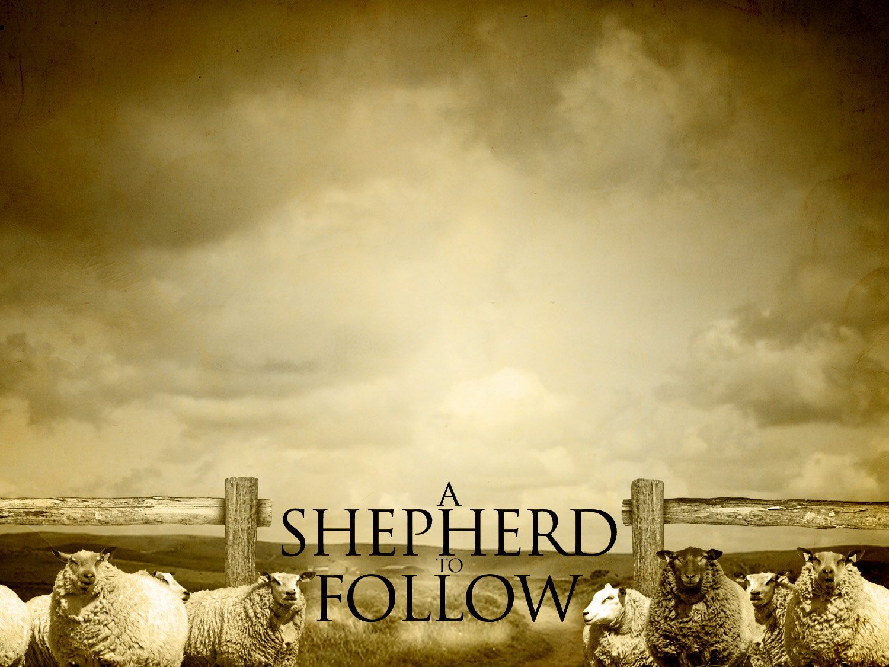
Jesus is the Great Shepherd
(Heb. 13:20)
sacrificial (Jn. 10:11)
provides (Ps. 23:1, 2)
comforts and cares for (Is. 40:11)
crowns the faithful (1 Pet. 5:4)

Slide 47
Divine Protection & Comfort (7:16, 17)
see Revelation 21:3, 4
For the Christian, the story of life does not end in this world’s trials
  Rom. 8:18; 2 Cor. 4:16-18

Slide 48
“In all the concern for security that surrounds us, there is a form of security that one hears little about. It is the security of our relationship to God. Yet it is the greatest of all securities, for it alone is a security that will continue, and what it guards is the best and deepest thing in life.”
Harry Boer, The Book of Revelation, p. 60, 1979

Slide 49
The Seventh Seal (8:1-5)
silence (v. 1)
seven angels given trumpets (v. 2)
  often sounded for battle or warning
  (1 Cor. 14:8; Joel 2:1, 2)
angel given incense to burn with prayers (vv. 3, 4; cf. Lk. 1:8-10)
fire thrown to earth (v. 5)

Slide 50
Lessons:
God hears the prayers of saints (1 Jn. 5:14, 15; Ps. 55:22, 23)
God is not indifferent to what goes on (Ps. 34:15; Pr. 5:21; 15:3; 1 Pet. 3:12)
We should revere the silence of heaven and wait patiently for the Lord’s response (Ps. 62:1)

